Slide 1
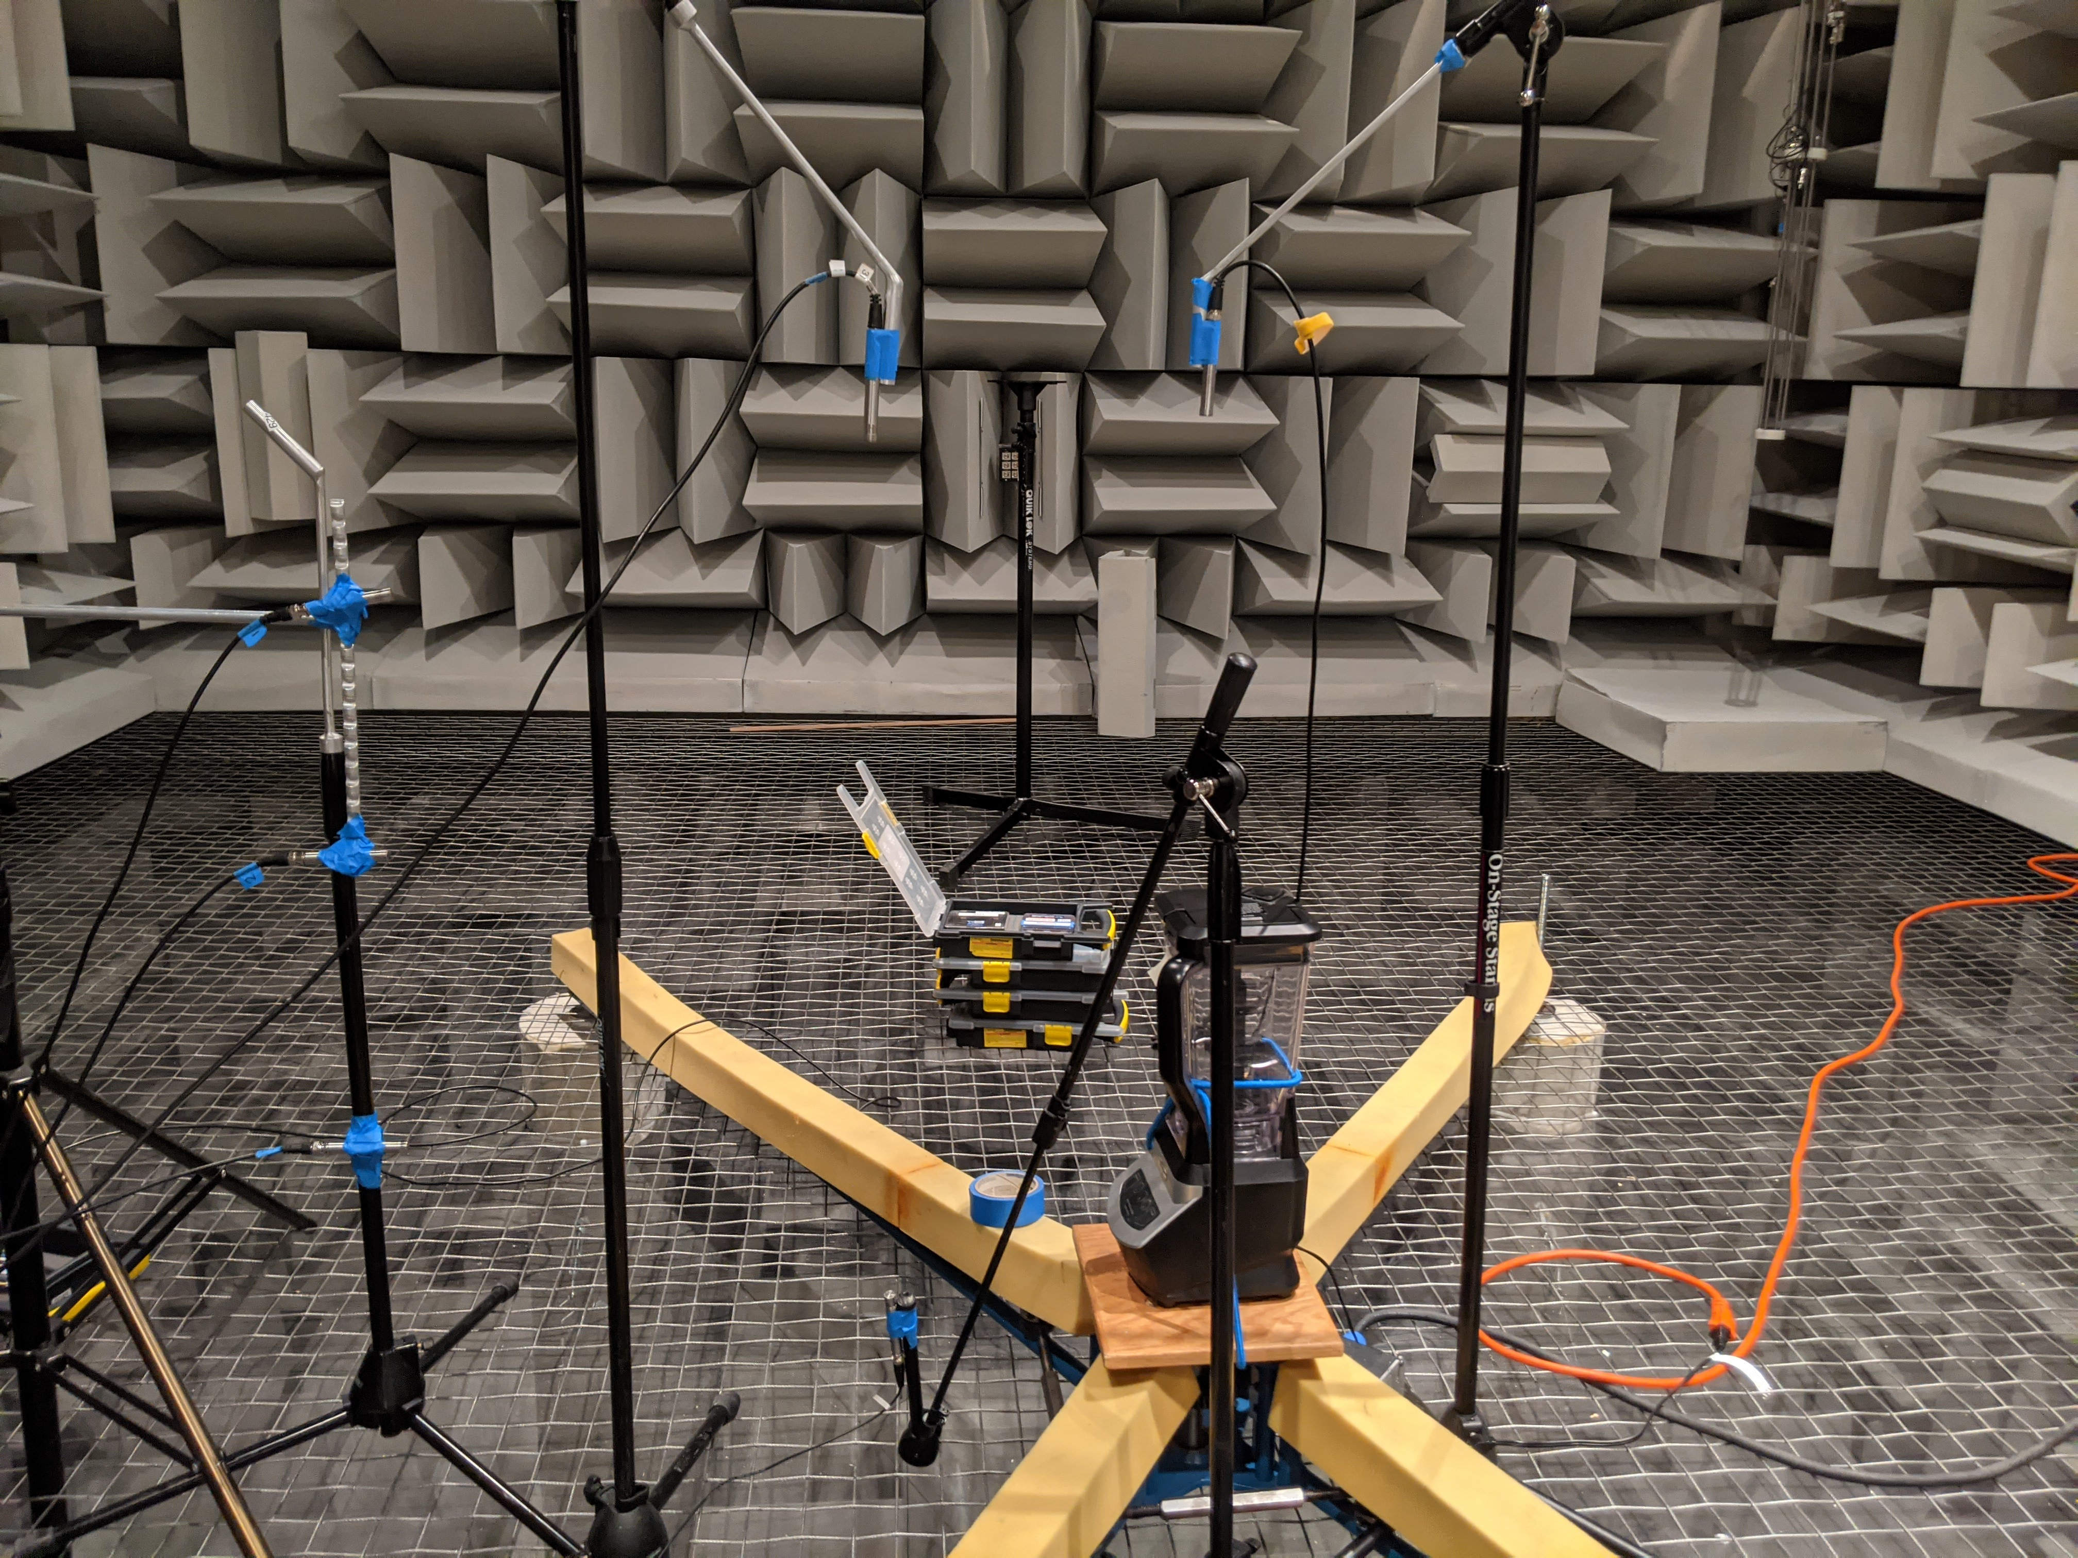
1. (35,46)
0. (0,46)
2. (80,33)
3. (80,6)
4. (80,-26)
5. (26,-39)

